Slide 1
Dot Net
Vikash Verma

Slide 2
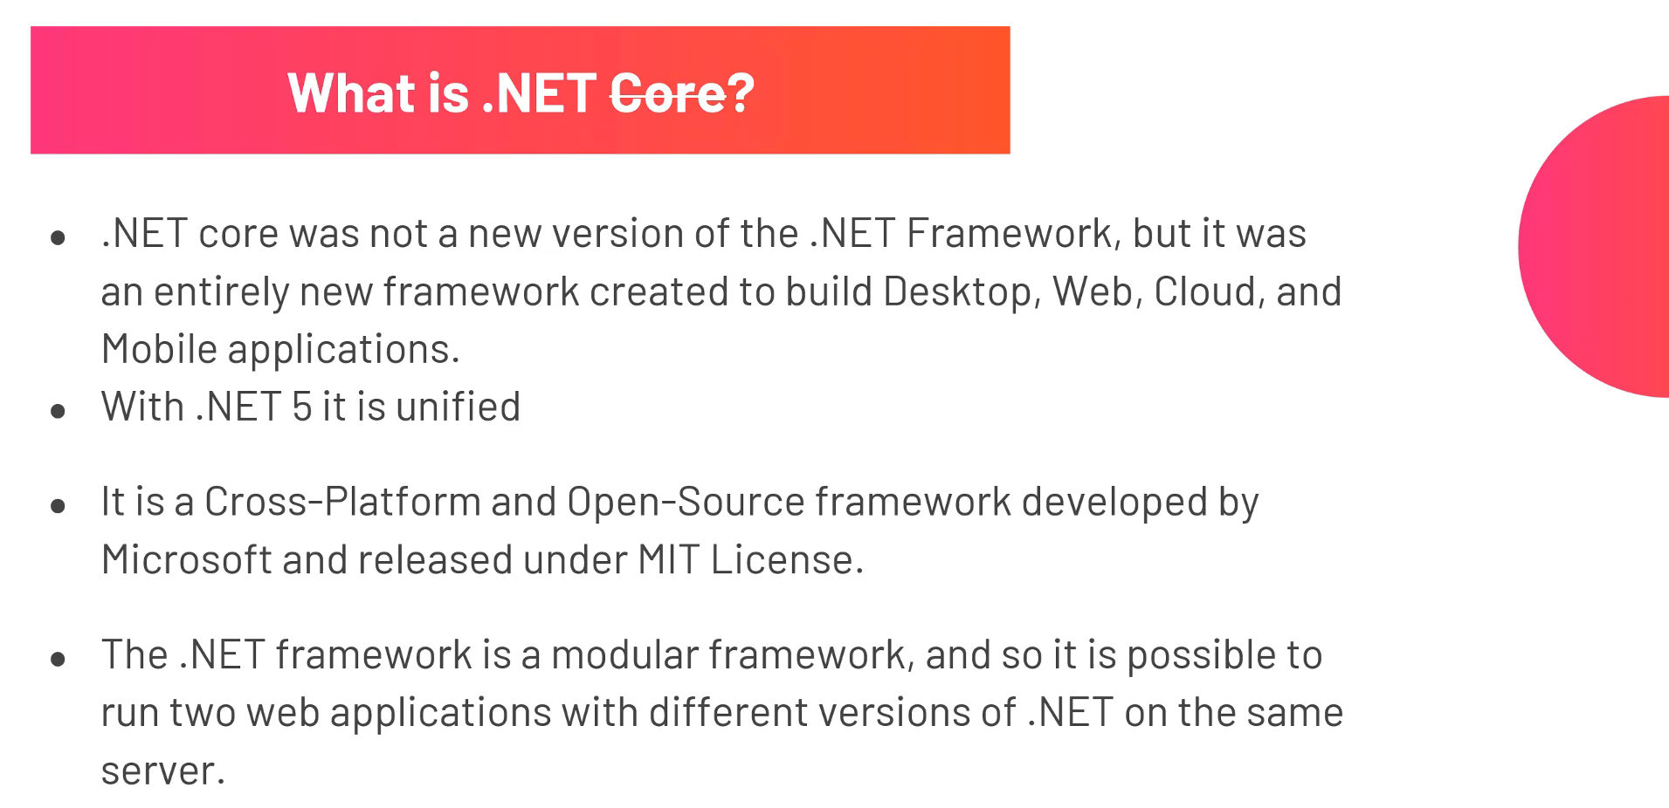
Dot Net Core

Slide 3
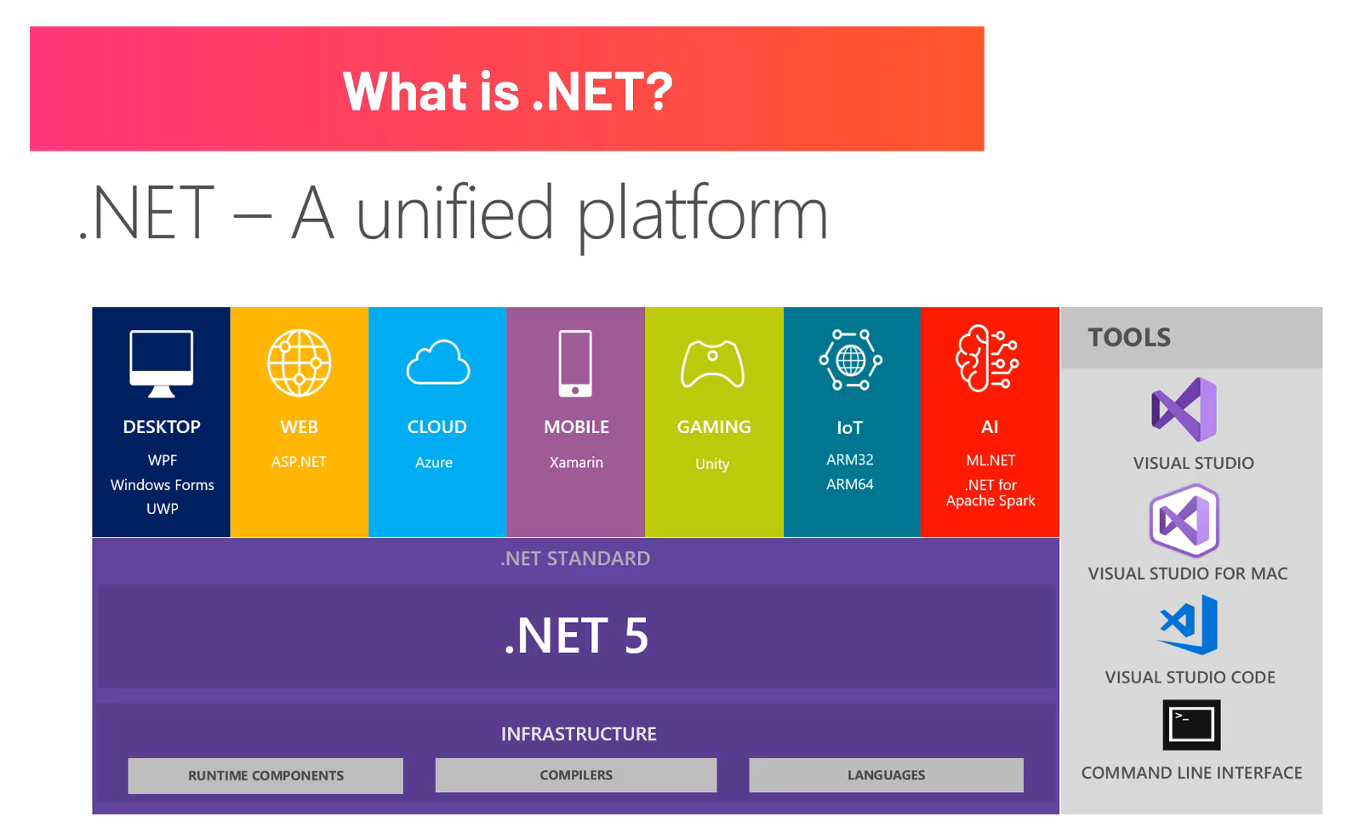
What is Dot NET ?

Slide 4
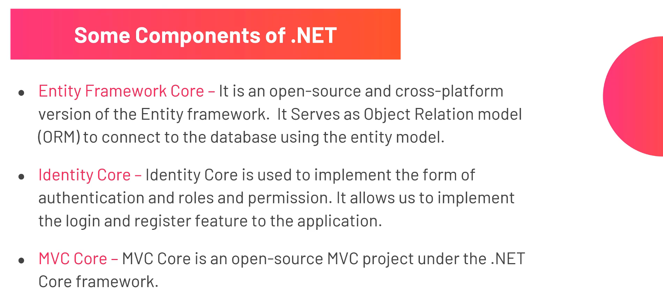
Components of Dot NET

Slide 5
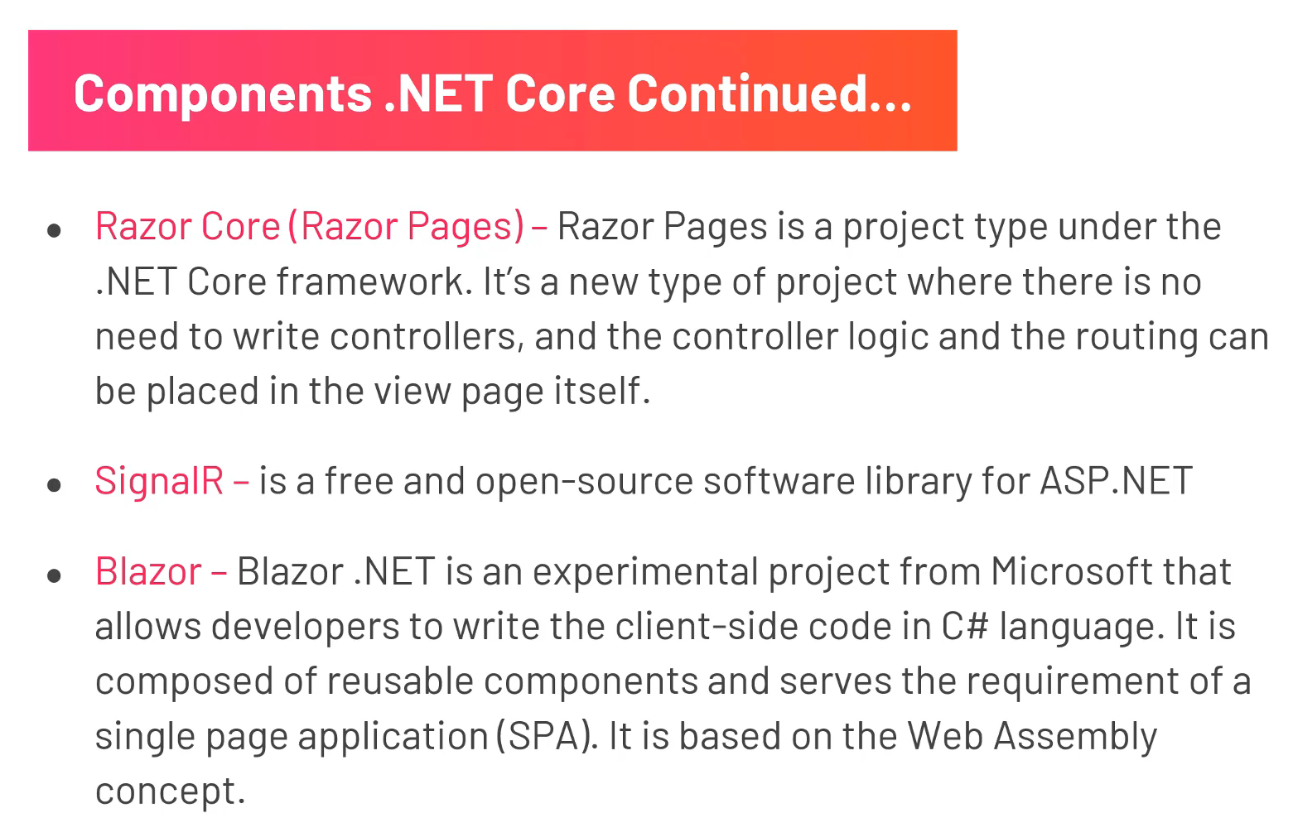
Dot Net Components

Slide 6
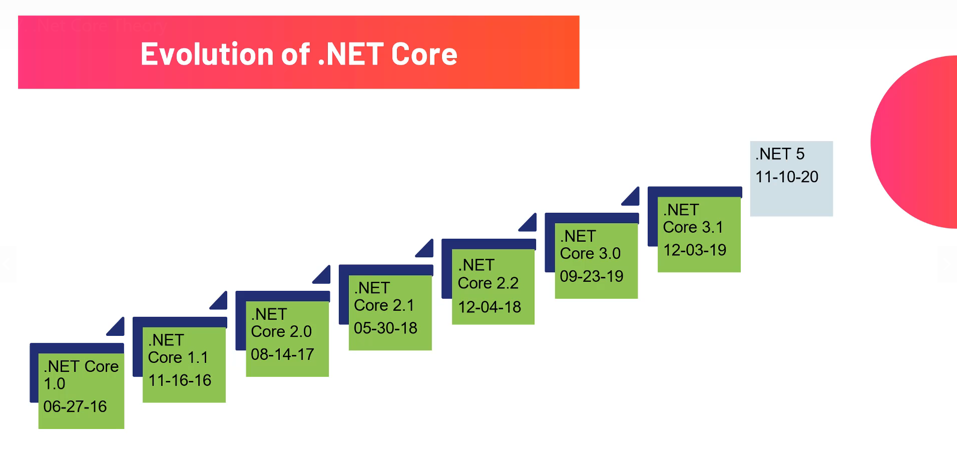
Dot Core Evolution

Slide 7
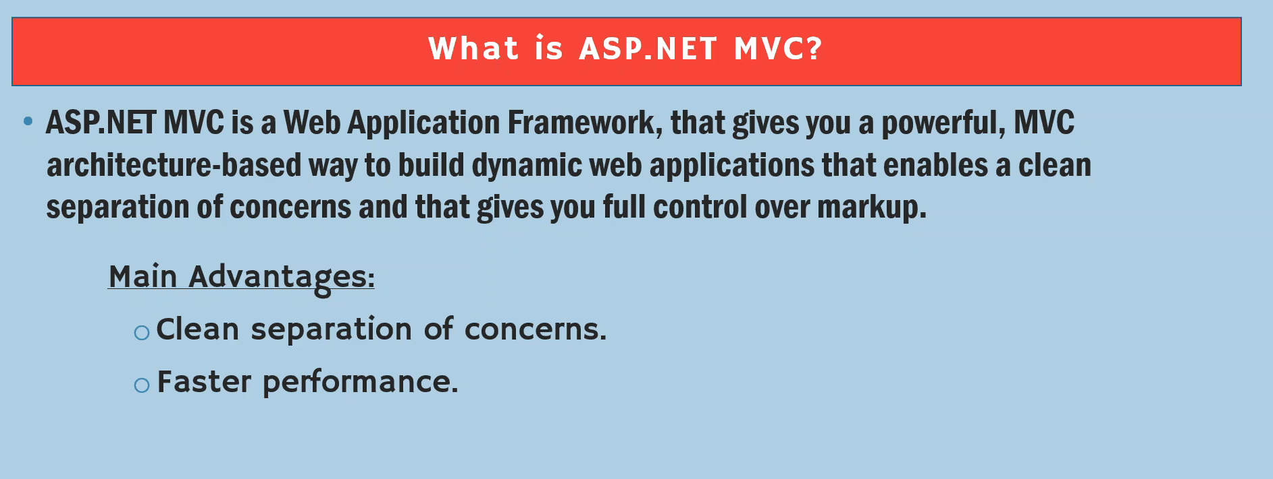
What is Asp.Net MVC

Slide 8
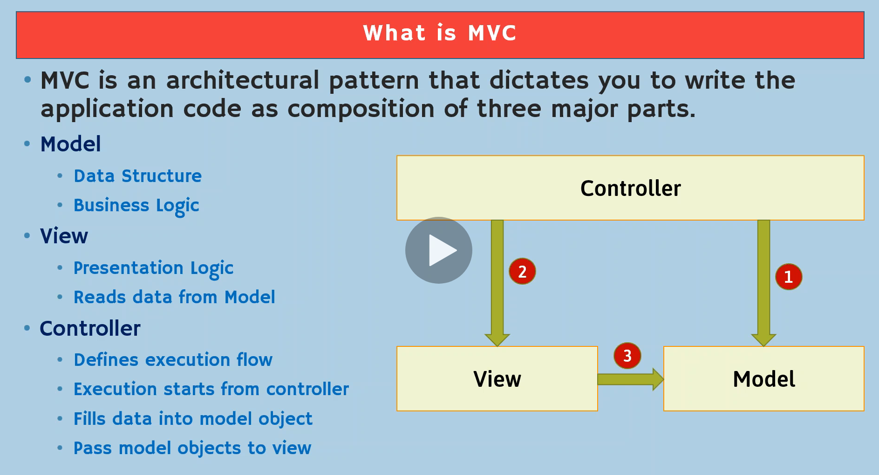
MVC

Slide 9
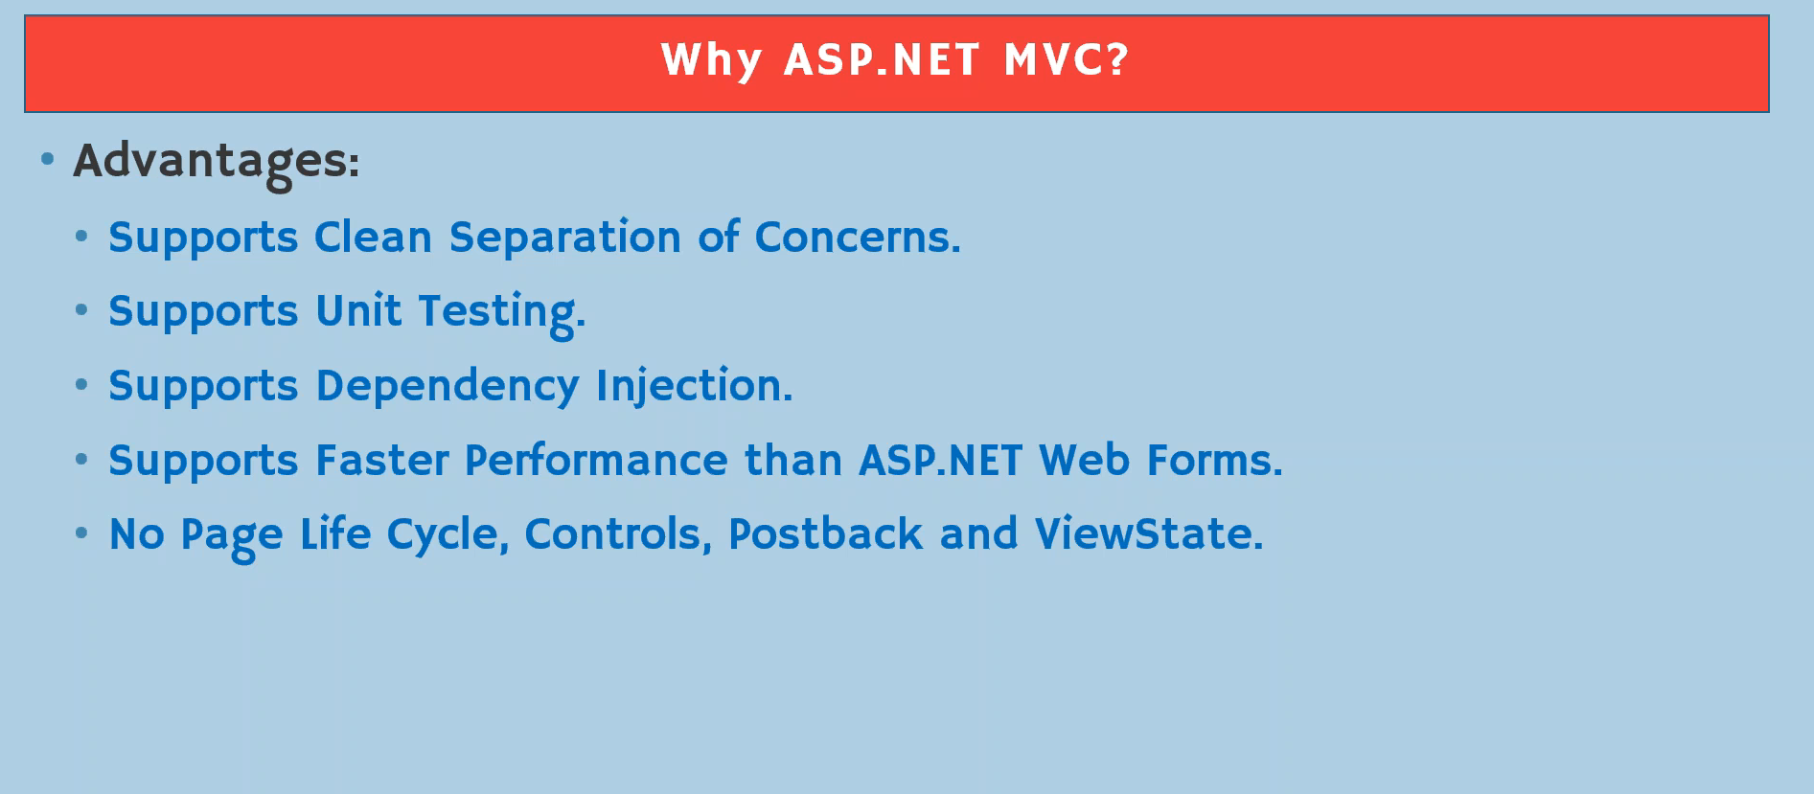
Why MVC?

Slide 10
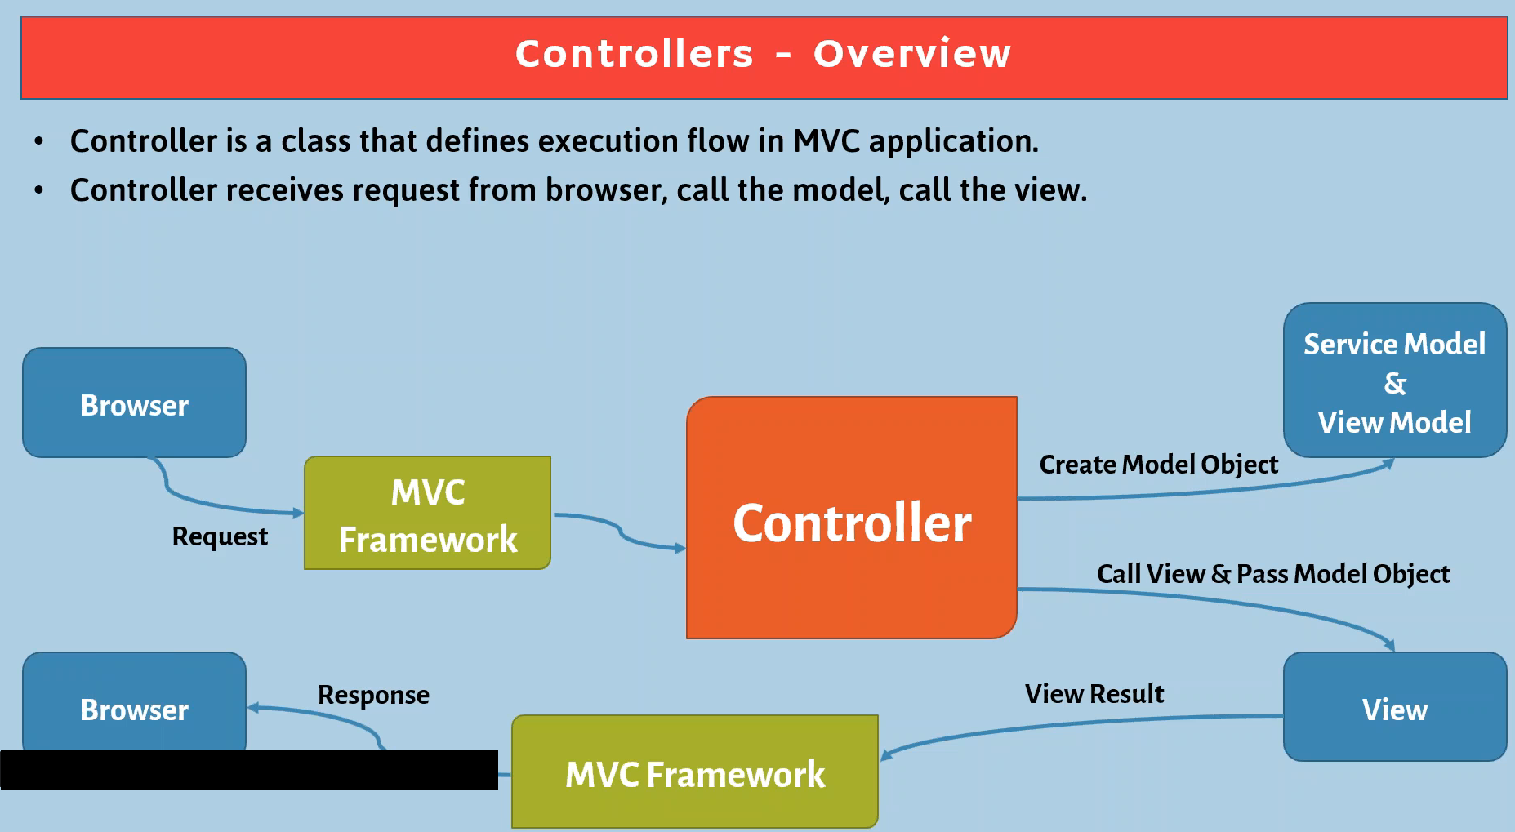
Controllers

Slide 11
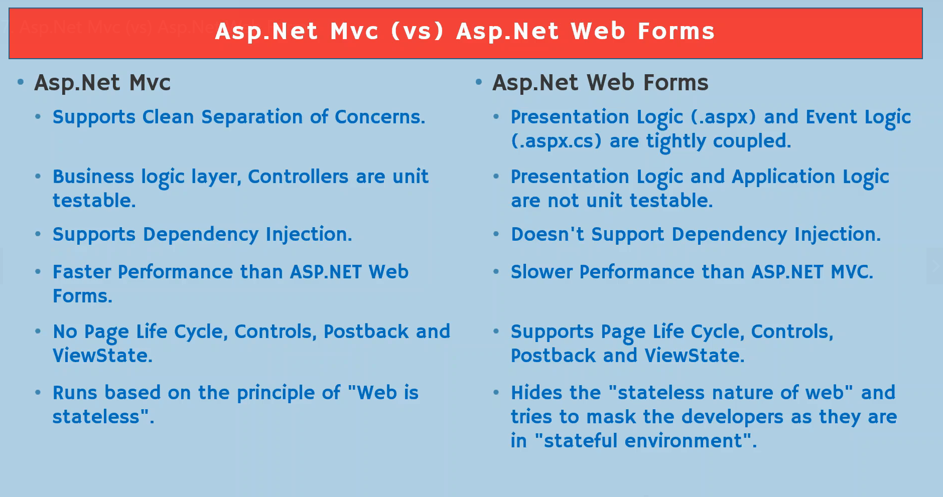
MVC vs Asp.NET web forms

Slide 12
Thanks !!

